Slide 1
Unit_03:Introduction to Linear Algebra
Mark Goldman
Emily Mackevicius

Slide 2
Outline
1. Matrix arithmetic
2. Matrix properties
3. Eigenvectors & eigenvalues
-BREAK-
4. Examples (on blackboard)
5. Recap, additional matrix properties, SVD

Slide 3
Part 1: Matrix Arithmetic
(w/applications to neural networks)

Slide 4
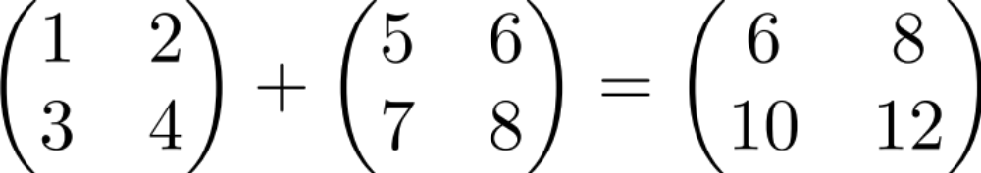
Matrix addition

Slide 5

Scalar times vector

Slide 6

Scalar times vector

Slide 7
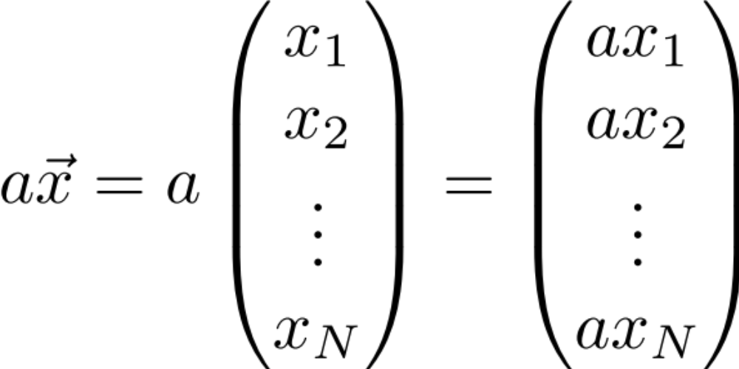
Scalar times vector

Slide 8
Product of 2 Vectors
Three ways to multiply
Element-by-element
Inner product
Outer product

Slide 9
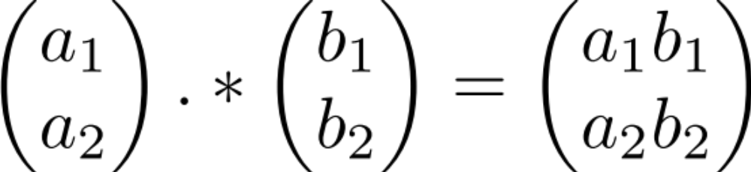
Element-by-element product (Hadamard product)
Element-wise multiplication (.* in MATLAB)

Slide 10
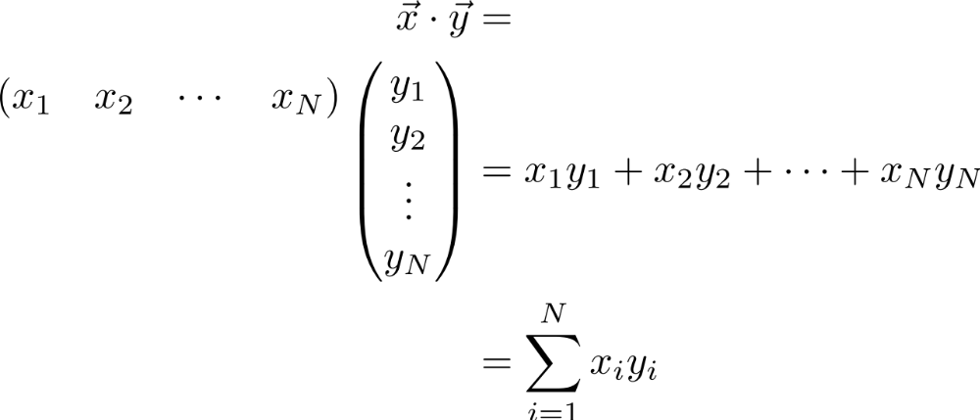
Multiplication:
Dot product (inner product)

Slide 11
Multiplication:
Dot product (inner product)

Slide 12
Multiplication:
Dot product (inner product)

Slide 13
Multiplication:
Dot product (inner product)

Slide 14
Multiplication:
Dot product (inner product)
1 X N
N X 1
1 X 1
MATLAB: ‘inner matrix dimensions must agree’
Outer dimensions give
size of resulting matrix

Slide 15



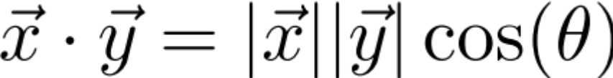
Dot product geometric intuition:
“Overlap” of 2 vectors

Slide 16
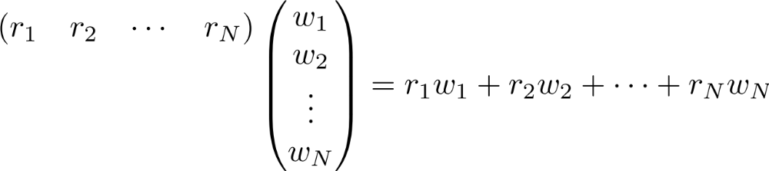
Example: linear feed-forward network
Input neurons’
Firing rates
r₁
r₂
r_{i}
r_{n}

Slide 17
Example: linear feed-forward network
Input neurons’
Firing rates
r₁
Synaptic weights
r₂
r_{i}
r_{n}

Slide 18
Example: linear feed-forward network
Input neurons’
Firing rates
r₁
Synaptic weights
r₂
Output neuron’s
firing rate
r_{i}
r_{n}

Slide 19



Example: linear feed-forward network
Input neurons’
Firing rates
Insight: for a given input (L2) magnitude, the response is maximized when the input is parallel to the weight vector
Receptive fields also can be thought of this way
r₁
Synaptic weights
r₂
Output neuron’s
firing rate
r_{i}
r_{n}

Slide 20
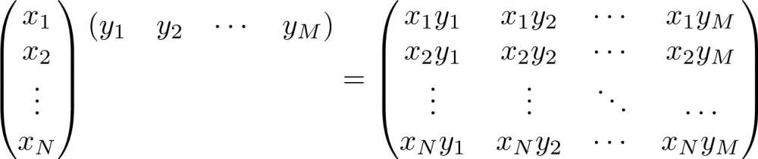
Multiplication: Outer product
N X 1
1 X M
N X M

Slide 21
Multiplication: Outer product

Slide 22
Multiplication: Outer product

Slide 23
Multiplication: Outer product

Slide 24
Multiplication: Outer product

Slide 25
Multiplication: Outer product

Slide 26

Multiplication: Outer product

Slide 27
Multiplication: Outer product
Note: each column or each row is a multiple of the others
Notes:
We’ll see implications of this feature shortly… (motivation for “rank 1”/1-dimensional matrix) and also underlying components of SVD

Slide 28
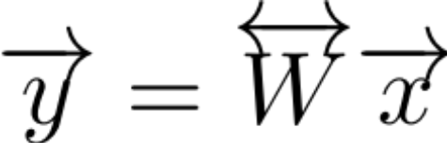
Matrix times a vector

Slide 29
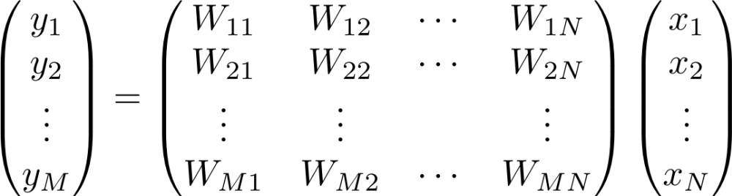
Matrix times a vector

Slide 30
Matrix times a vector
M X 1
M X N
N X 1

Slide 31
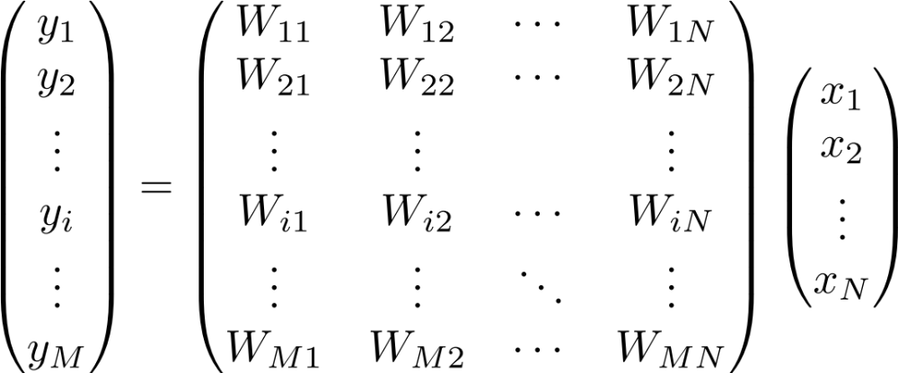
Matrix times a vector: inner product interpretation
Rule: the i^{th} element of y is the dot product of the i^{th} row of W with x

Slide 32
Matrix times a vector: inner product interpretation
Rule: the i^{th} element of y is the dot product of the i^{th} row of W with x

Slide 33
Matrix times a vector: inner product interpretation
Rule: the i^{th} element of y is the dot product of the i^{th} row of W with x

Slide 34
Matrix times a vector: inner product interpretation
Rule: the i^{th} element of y is the dot product of the i^{th} row of W with x

Slide 35
Matrix times a vector: inner product interpretation
Rule: the i^{th} element of y is the dot product of the i^{th} row of W with x

Slide 36

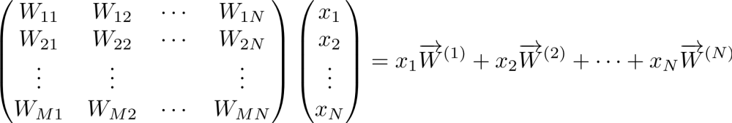
Matrix times a vector: outer product interpretation
The product is a weighted sum of the columns of W, weighted by the entries of x

Slide 37
Matrix times a vector: outer product interpretation
The product is a weighted sum of the columns of W, weighted by the entries of x

Slide 38
Matrix times a vector: outer product interpretation
The product is a weighted sum of the columns of W, weighted by the entries of x

Slide 39
Matrix times a vector: outer product interpretation
The product is a weighted sum of the columns of W, weighted by the entries of x

Slide 40

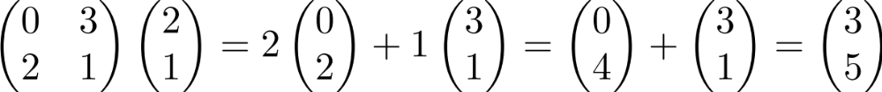
Example of the outer product method

Slide 41
Example of the outer product method
(0,2)
(3,1)

Slide 42
Example of the outer product method
(0,4)
(3,1)

Slide 43
Example of the outer product method
(3,5)
Note: different combinations of the columns of M can give you any vector in the plane
(we say the columns of M
“span” the plane)

Slide 44
Rank of a Matrix
Are there special matrices whose columns don’t span the full plane?

Slide 45
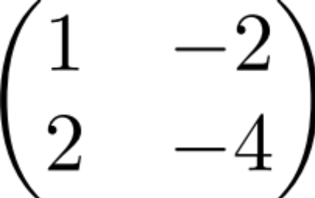
Rank of a Matrix
Are there special matrices whose columns don’t span the full plane?
(1,2)
(-2, -4)
You can only get vectors along the (1,2) direction (i.e. outputs live in 1 dimension, so we call the matrix rank 1)
Notes:
Such rank 1 matrices can be written as an outer product, e.g. in this case as (1 2)’ * (1 -2)

Slide 46



Example: 2-layer linear network
W_{ij} is the connection strength (weight) onto neuron y_{i} from neuron x_{j}.

Slide 47
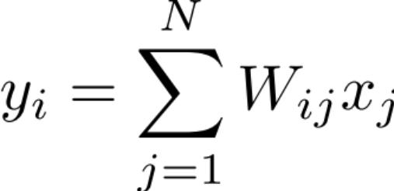

Example: 2-layer linear network: inner product point of view
What is the response of cell y_{i} of the second layer?
The response is the dot product of the i^{th} row of W with the vector x

Slide 48

Example: 2-layer linear network: outer product point of view
How does cell x_{j} contribute to the pattern of firing of layer 2?
1st column
of W
Contribution
of x_{j} to
network output

Slide 49
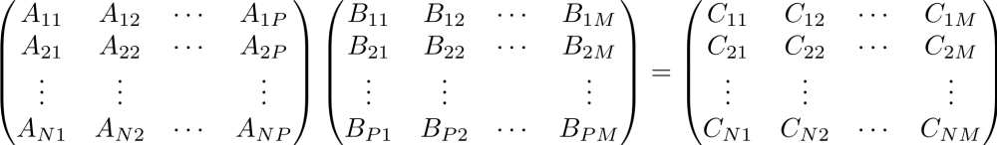
Product of 2 Matrices
N X P
P X M
N X M
MATLAB: ‘inner matrix dimensions must agree’
Note: Matrix multiplication doesn’t (generally) commute, AB ≠ BA

Slide 50
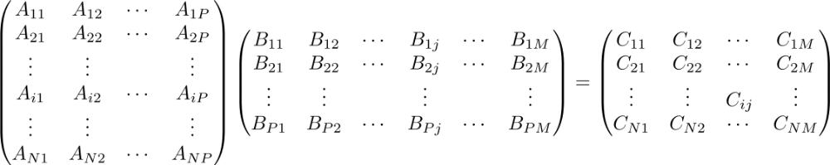
Matrix times Matrix: by inner products
C_{ij} is the inner product of the i^{th} row with the j^{th} column

Slide 51
Matrix times Matrix: by inner products
C_{ij} is the inner product of the i^{th} row with the j^{th} column

Slide 52
Matrix times Matrix: by inner products
C_{ij} is the inner product of the i^{th} row with the j^{th} column

Slide 53
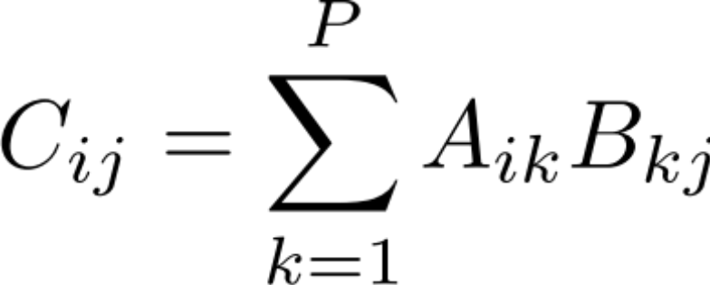
Matrix times Matrix: by inner products
C_{ij} is the inner product of the i^{th} row of A with the j^{th} column of B

Slide 54
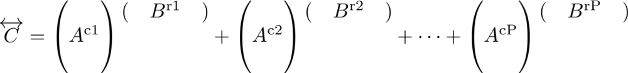
Matrix times Matrix: by outer products

Slide 55
Matrix times Matrix: by outer products

Slide 56
Matrix times Matrix: by outer products

Slide 57
Matrix times Matrix: by outer products
C is a sum of outer products of the columns of A with the rows of B
Notes:
Note: this way of matrix multiplying, i.e. breaking into outer products is key to Singular Value Decomposition (SVD) which I’ll discuss at end of lecture; note that each outer product is rank 1 since each column (or row) is a multiple of every other column (or row)

Slide 58
Part 2: Matrix Properties
(A few) special matrices
Matrix transformations & the determinant
Matrices & systems of algebraic equations

Slide 59
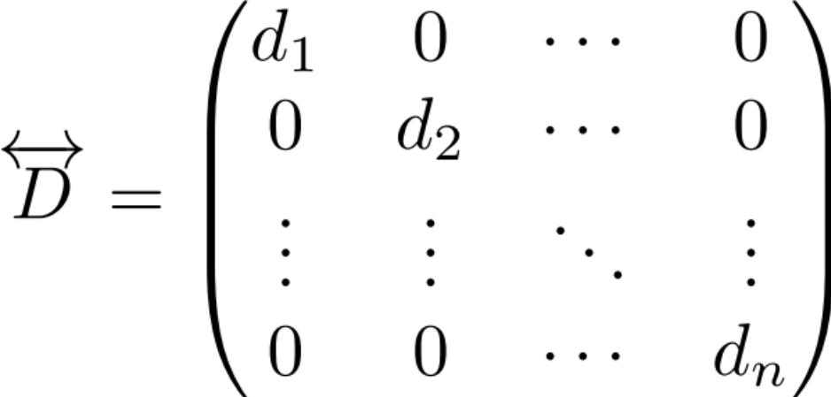
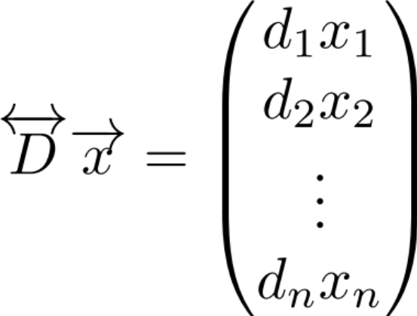
Special matrices: diagonal matrix
This acts like scalar multiplication

Slide 60
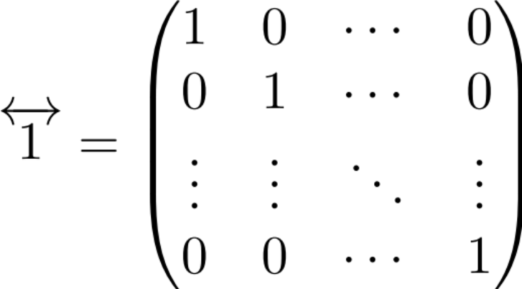
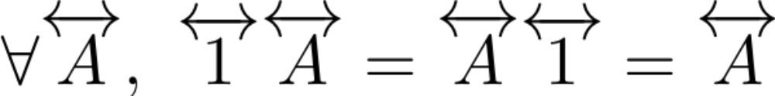
Special matrices: identity matrix
for all

Slide 61
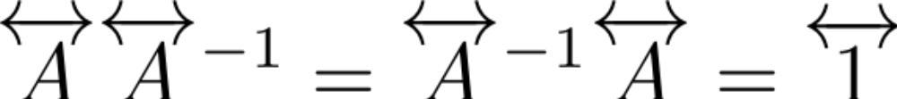
Special matrices: inverse matrix
Does the inverse always exist?
Notes:
For scalars, there is no inverse if the scalar’s value is 0. For matrices, the corresponding quantity that has to be nonzero for the inverse to exist is called the determinant, which we’ll show next corresponds geometrically (up to a sign) to an area (or, in higher dimensions, volume).

Slide 62
How does a matrix transform a square?
(0,1)
(1,0)

Slide 63
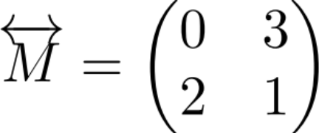
How does a matrix transform a square?
(0,1)
(1,0)

Slide 64
How does a matrix transform a square?
(0,2)
(0,1)
(3,1)
(1,0)
Notes:
Note, potentially a bit confusing: the vector (1,0) got mapped into (0,2) and (0,1) got mapped into (3,1): this relates to fact that determinant is negative (i.e. in some sense, orientation of parallelogram flipped)

Slide 65
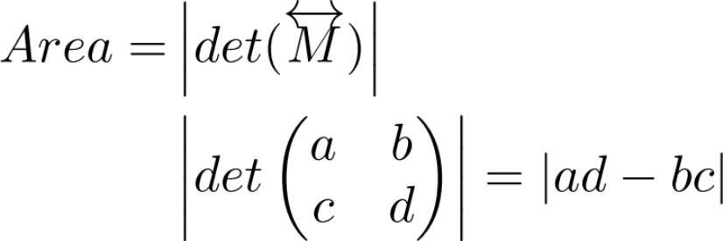
Geometric definition of the determinant: How does a matrix transform a square?
(0,1)
(1,0)

Slide 66
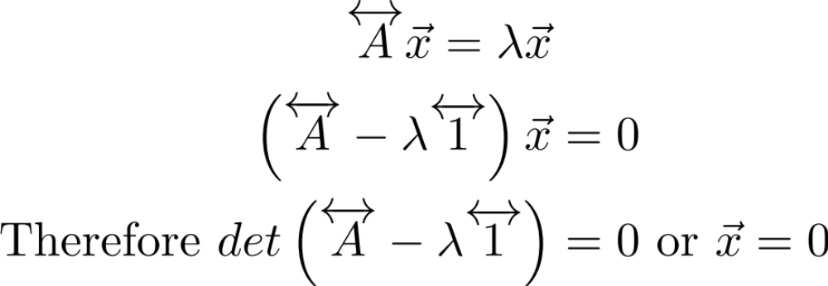
Example: solve the algebraic equation

Slide 67
Example: solve the algebraic equation

Slide 68
Example: solve the algebraic equation
⇒
Notes:
If above determinant is zero, then inverse doesn’t exist and can’t conclude that x=0 by simply multiplying both sides of the equation by the inverse.

Slide 69
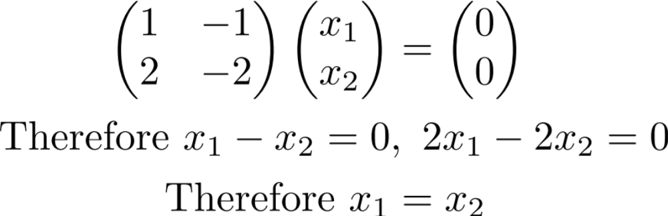
Example of an underdetermined system
Some non-zero vectors are sent to 0

Slide 70
Example of an underdetermined system
Some non-zero vectors are sent to 0

Slide 71
Example of an underdetermined system
⇒

Slide 72
Example of an underdetermined system
⇒
Some non-zero x are sent to 0 (the set of all x with Mx=0 are called the “nullspace” of M)
This is because det(M)=0 so M is not invertible. (If det(M) isn’t 0, the only solution is x = 0)
Notes:
c

Slide 73
Part 3: Eigenvectors & eigenvalues

Slide 74
What do matrices do to vectors?
(0,2)
(2,1)
(3,1)

Slide 75
Recall
(3,5)
(2,1)

Slide 76
What do matrices do to vectors?
(3,5)
The new vector is:
1) rotated
2) scaled
(2,1)

Slide 77
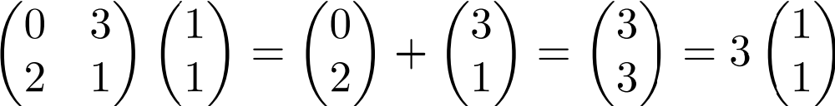
Are there any special vectors that only get scaled?

Slide 78
Are there any special vectors that only get scaled?
Try (1,1)

Slide 79
Are there any special vectors that only get scaled?
= (1,1)

Slide 80
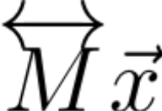
Are there any special vectors that only get scaled?
= (3,3)
= (1,1)

Slide 81
Are there any special vectors that only get scaled?
For this special vector, multiplying by M is like multiplying by a scalar.
(1,1) is called an eigenvector of M
3 (the scaling factor) is called the eigenvalue associated with this eigenvector
= (3,3)
= (1,1)

Slide 82
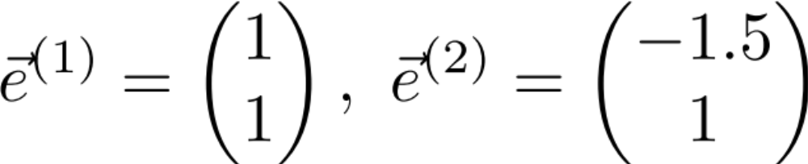
Are there any other eigenvectors?
Yes! The easiest way to find is with MATLAB’s eig command.
Exercise: verify that (-1.5, 1) is also an eigenvector of M.
Note: eigenvectors are only defined up to a scale factor.
  Conventions are either to make e’s unit vectors, or make one of the elements 1

Slide 83
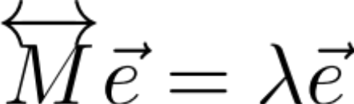
Step back:
Eigenvectors obey this equation

Slide 84
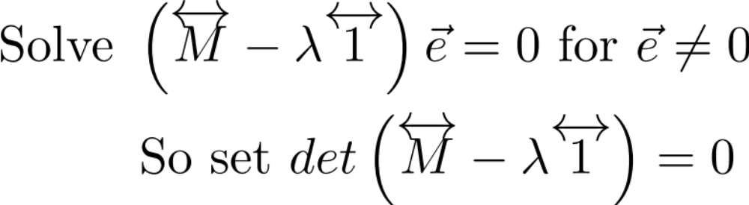
Step back:
Eigenvectors obey this equation

Slide 85
Step back:
Eigenvectors obey this equation

Slide 86
Step back:
Eigenvectors obey this equation
This is called the characteristic equation for λ
In general, for an N x N matrix, there are N eigenvectors

Slide 87

BREAK

Slide 88
Part 4: Examples (on blackboard)
Principal Components Analysis (PCA)
Single, linear differential equation
Coupled differential equations

Slide 89
Part 5: Recap & Additional useful stuff
Matrix diagonalization recap:
transforming between original & eigenvector coordinates
More special matrices & matrix properties
Singular Value Decomposition (SVD)

Slide 90
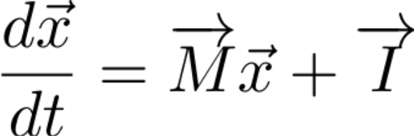

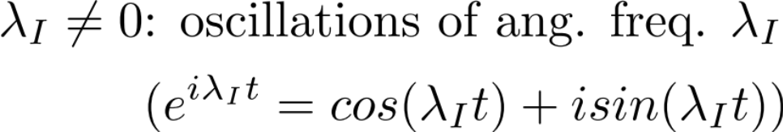
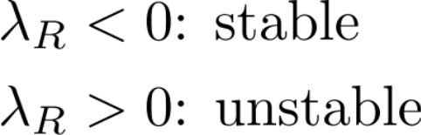
Coupled differential equations
Calculate the eigenvectors and eigenvalues.
  Eigenvalues have typical form:
The corresponding eigenvector component has dynamics:

Slide 91
Practical program for approaching equations coupled through a term Mx
Step 1: Find the eigenvalues and eigenvectors of M.
Step 2: Decompose x into its eigenvector components
Step 3: Stretch/scale each eigenvalue component
Step 4: (solve for c and) transform back to original coordinates.
eig(M) in MATLAB

Slide 92
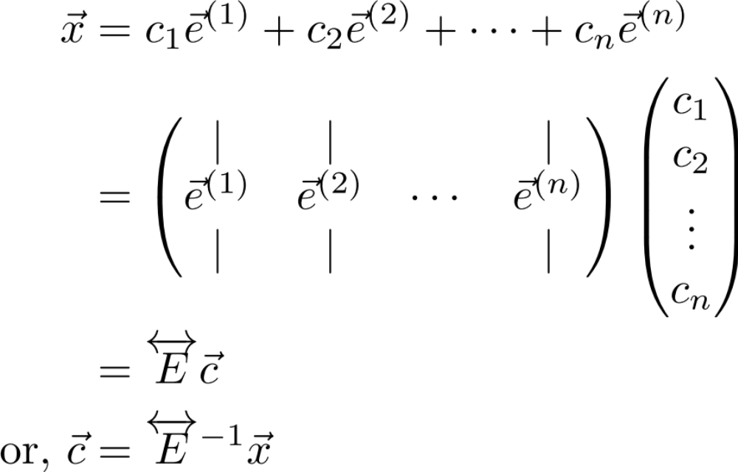
Practical program for approaching equations coupled through a term Mx
Step 1: Find the eigenvalues and eigenvectors of M.
Step 2: Decompose x into its eigenvector components
Step 3: Stretch/scale each eigenvalue component
Step 4: (solve for c and) transform back to original coordinates.

Slide 93
Practical program for approaching equations coupled through a term Mx
Step 1: Find the eigenvalues and eigenvectors of M.
Step 2: Decompose x into its eigenvector components
Step 3: Stretch/scale each eigenvalue component
Step 4: (solve for c and) transform back to original coordinates.

Slide 94
Practical program for approaching equations coupled through a term Mx
Step 1: Find the eigenvalues and eigenvectors of M.
Step 2: Decompose x into its eigenvector components
Step 3: Stretch/scale each eigenvalue component
Step 4: (solve for c and) transform back to original coordinates.
Notes:
Step 4: (solve for c and) transform back to original coordinates.

Slide 95
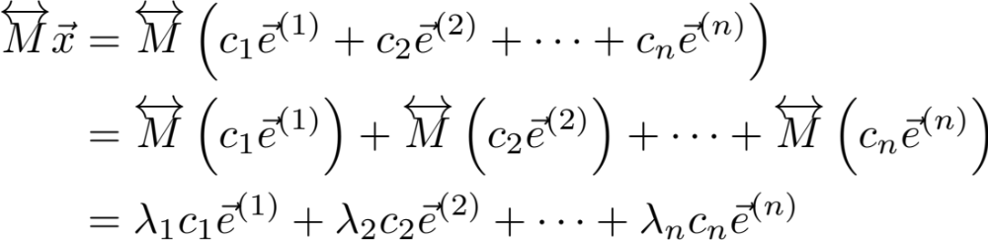
Practical program for approaching equations coupled through a term Mx
Step 1: Find the eigenvalues and eigenvectors of M.
Step 2: Decompose x into its eigenvector components
Step 3: Stretch/scale each eigenvalue component
Step 4: (solve for c and) transform back to original coordinates.

Slide 96
Practical program for approaching equations coupled through a term Mx
Step 1: Find the eigenvalues and eigenvectors of M.
Step 2: Decompose x into its eigenvector components
Step 3: Stretch/scale each eigenvalue component
Step 4: (solve for c and) transform back to original coordinates.

Slide 97
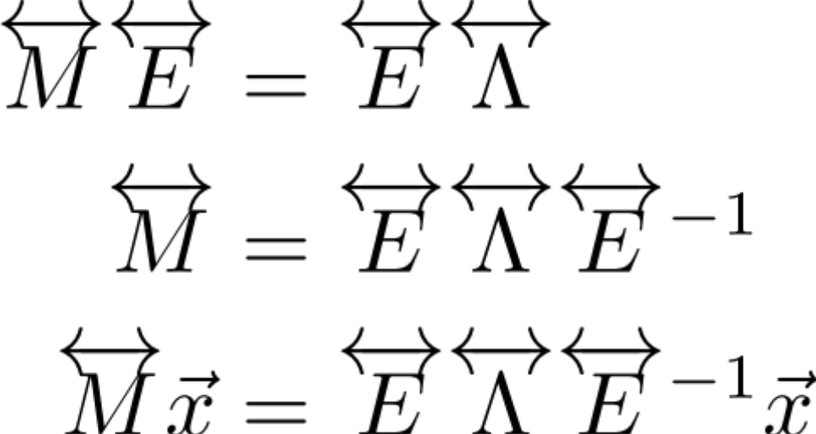
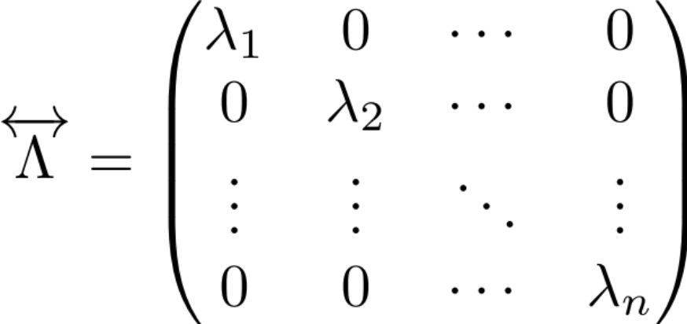
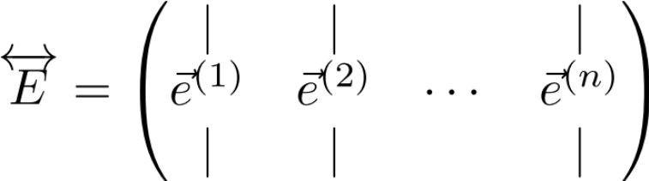
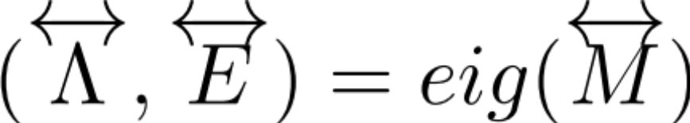
Putting it all together…
Where (step 1):
MATLAB:

Slide 98
Putting it all together…
Step 2: Transform into eigencoordinates
Step 4: Transform back to original coordinate system
Step 3: Scale by λ_{i} along the i^{th} eigencoordinate

Slide 99
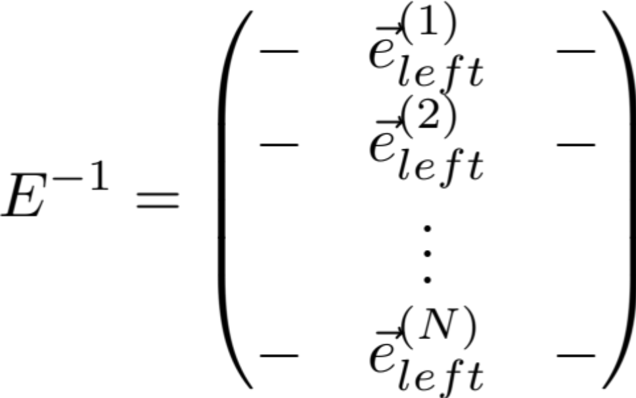
Left eigenvectors
-The rows of E inverse are called the left eigenvectors
because they satisfy E⁻¹ M = Λ E⁻¹.
-Together with the eigenvalues, they determine how x is decomposed into each of its eigenvector components.
Notes:
Notes:
1) sometimes left eigenvectors are called adjoint eigenvectors
2) later we’ll show that in some cases the right and left eigenvectors are the same (Normal matrices). It is easily shown that they obey the equation:
e_left M = lambda * e_left, i.e. they are analogous to the usual (right) eigenvectors except that they multiply M from the *left* (and they must be written as row vectors to do this).
Proof (can do on board): M = E*Lambda*E^(-1)
E^(-1) M = Lambda*E^(-1)
3) the left eigenvectors of M transpose are the same as the right eigenvectors of M
Proof: M*E = E * Lambda
E’ * M’ = Lambda * E’ (i.e. rows of E’ are the left eigenvectors of M’, and are identical to columns of E)
4) Even though eigenvectors are not necessarily orthogonal, left & right eigenvectors corresponding to distinct eigenvalues are orthogonal
Proof: follows directly from E^(-1) * E = Identity
.

Slide 100
Putting it all together…
Original Matrix
Matrix in eigencoordinate system
Where:

Slide 101
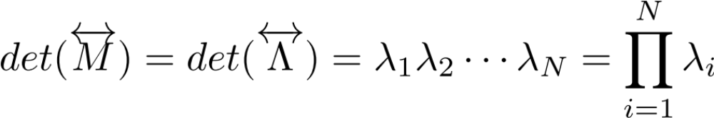
Trace and Determinant
Original Matrix
Matrix in eigencoordinate system
Note: M and Lambda look very different.
Q: Are there any properties that are preserved between them?
A: Yes, 2 very important ones:
1.
2.

Slide 102
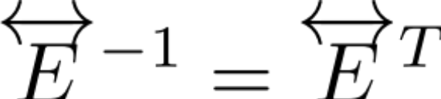
Special Matrices: Normal matrix
Normal matrix: all eigenvectors are orthogonal
→ Can transform to eigencoordinates (“change basis”) with a simple rotation* of the coordinate axes
→ A normal matrix’s eigenvector matrix E is a *generalized rotation (unitary or orthonormal) matrix, defined by:
Picture:
E
(*note: generalized means one can also do reflections of the eigenvectors through a line/plane”)
Notes:
Key feature: if decomposing a general vector into components in an orthonormal coordinate system, then do this through simple orthogonal projection along the orthonormal axes of the coordinate system. This can be done through a dot product (as noted near the beginning of this tutorial…). Since transforming into the eigenvector coordinate system is accomplished by a dot product with the rows of E^(-1), we see that this operation is simply a dot product with the eigenvectors when we have E^(-1) = E transpose.
Note: reflections could technically be through any axis, because one can then rotate more to make up for which axis one reflected through. Note that performing reflection changes the sign of the determinant (e.g. from =1 to -1). [Aside/not relevant here but for cultural interest: Unitary or orthonormal matrices that are restricted to have positive determinant (= +1) are called “special unitary” or “special orthonormal” matrices.] Also note that the absolute value of the determinant equaling 1 for unitary/orthonormal matrices reflects the earlier comment that determinants give the area of the transformation of a unit square, and a rotation matrix is area-preserving.

Slide 103
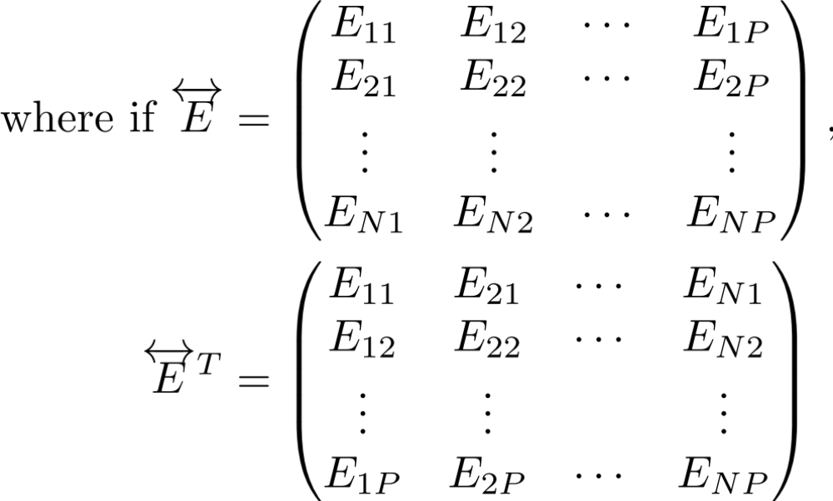
Special Matrices: Normal matrix
Normal matrix: all eigenvectors are orthogonal
→ Can transform to eigencoordinates (“change basis”) with a simple rotation of the coordinate axes
→ E is a rotation (unitary or orthogonal) matrix, defined by:
where if:
then:

Slide 104
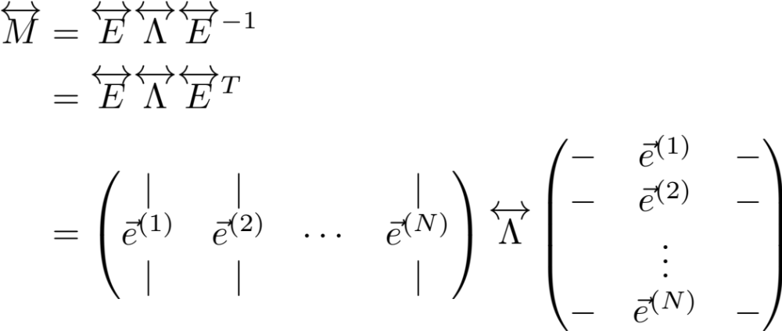
Special Matrices: Normal matrix
Eigenvector decomposition in this case:
Left and right eigenvectors are identical!

Slide 105
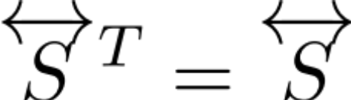
Special Matrices
Symmetric Matrix:
e.g. Covariance matrices, Hopfield network
Properties:
  Eigenvalues are real
  Eigenvectors are orthogonal (i.e. it’s a normal matrix)
Notes:
Proof that eigvals real: Suppose Av = (lambda)v, where lambda potentially complex and A = A’ (‘ denotes transpose) and A real-valued
Consider v’*Av = v’*(Av) = lambda v’*v = lambda |v|^2, where * denotes complex conjugate (NOT multiplication)
but also v’*Av = (v’*A)v = (A’v*)’v = (Av*)’v = lambda* |v|^2
Thus, lambda = lambda* → lambda real
Proof that eigvectors orthogonal: now consider two eigenvectors v and w with distinct eigenvalues
Consider v’Aw two ways above to see that v’w must equal zero
Note: covariance matrices have further restriction that eigenvalues are positive, this results from the fact that covariance matrices are of the form XX’

Slide 106
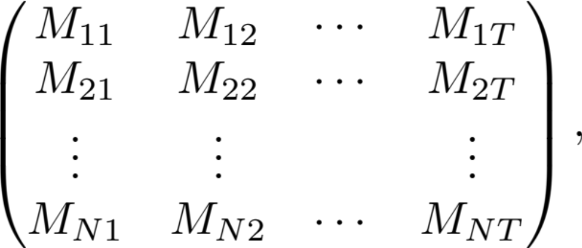
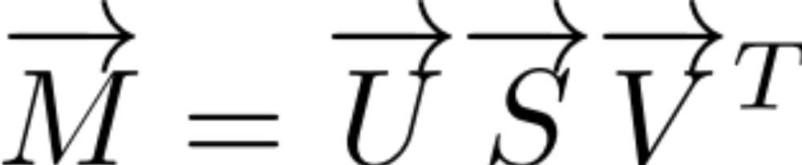

SVD: Decomposes matrix into outer products
(e.g. of a neural/spatial mode and a temporal mode)
t = 1
t = 2
t = T
n = 1
n = 2
n = N

Slide 107
SVD: Decomposes matrix into outer products
(e.g. of a neural/spatial mode and a temporal mode)
t = 1
t = 2
t = T
n = 1
n = 2
n = N

Slide 108
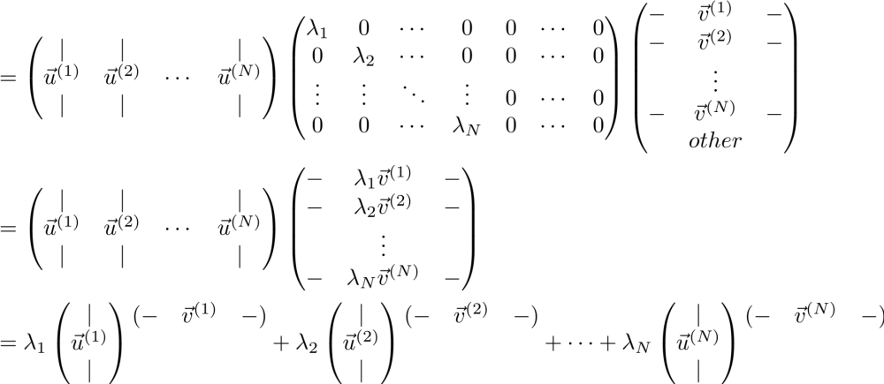
SVD: Decomposes matrix into outer products
(e.g. of a neural/spatial mode and a temporal mode)
Columns of U are eigenvectors of MM^{T}
Rows of V^{T} are
eigenvectors of M^{T}M
Note: the eigenvalues are the same for M^{T}M and MM^{T}

Slide 109
SVD: Decomposes matrix into outer products
(e.g. of a neural/spatial mode and a temporal mode)
Columns of U are eigenvectors of MM^{T}
Rows of V^{T} are
eigenvectors of M^{T}M
Thus, SVD pairs “spatial” patterns with associated “temporal” profiles through the outer product
Notes:
Note 1: Each neural mode has an associated temporal mode, and that M can be written as a linear sum of outer products.
Note 2: Alternatively, the time course of each spatial mode (i.e. the strength of the spatial mode at each point in time) is given by the associated temporal eigenvector times the singular value. Sometimes people refer to each temporal eigenvector scaled by its singular value as the temporal ‘component’ to distinguish it from the spatial ‘mode’.
Note 3: remember that outer products are 1d (i.e. rank 1)
Note 4: if you are centering your data, you can subtract off the mean of *either* your rows *or* your columns, but you cannot do both (i.e. first subtract off mean of rows, then subtract off means of resulting columns) or you will lose a dimension. More generally, if you think of your individual data points as occupying either the rows or columns of M, then you want to do the operation that corresponds to subtracting the means of the data points, i.e. “centering the data”; if you do the other mean subtraction, you will see that your data loses a dimension. Try this with a 2x3 matrix, plotting it with the interpretation of its being 3 two-dimensional data points to see what happens if you subtract off the “wrong mean”.

Slide 110
The End

